Slide 1
Adversarial Search & Game Playing
“Problems that arise when we try to plan ahead in a world where others agents are planning against us.”
Notes:
- Announcements: In-class quiz: We will post solution online (Zhenhua, go and bug David), people who handed in paper will get score for participation

Slide 2
Puzzles and games have long been considered a challenge for human intelligence:
Chess in Persia and India ~4000 years ago
Checkers in 3600-year-old Egyptian paintings
Go in China over 3000 years ago

Slide 3
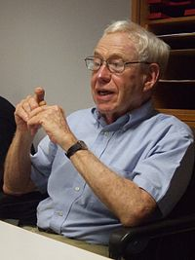
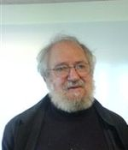
At the beginning
1966 Hubert Dreyfus writes
“computers cannot play chess”…
Seymour Papert arranged for a match
Between Dreyfus and “Mac Hack”.
Dreyfus lost
Notes:
Hubert Dreyfus, Philosopher at Berkley
Seymour Papert, Computer scientist at MIT
Mac Hack first computer to be granted a chess rating, and the first to win against a person in tournament play. 1967

Slide 4
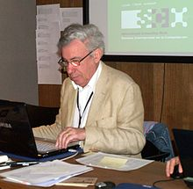
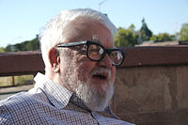
In 1968, David Levy, IM, had a friendly game against John McCarthy, which he won.
McCarthy then bet that within 10 years, a computer could beat Levy. They had a bet of 500 pounds
Levy won the bet in 1978. The first computer program that beat him was “Deep Thought”, in 1989.
Notes:
David M. Levy, Computer Scientist
John McCarthy, one of founders of the term Artificial Intelligence
Deep Thought (CMU and IBM), predecessor of deep blue
Deep Thought became the first computer to beat a grandmaster, but was easily defeated by Garry Kasparov

Slide 5
Game Playing vs. the “Real World”
Games are compact settings that mimic the uncertainty of interacting with the natural world
Games are (kind of) like the real world:
I have a goal (to win) that I want to work/plan towards
I have to decide among many possible actions
Other agents can try to keep me form achieving my goal
Game are much “simpler” than the real world:
Chess: I need to know the rules of chess and the state of the chess board
Finding the right campus building: So many things to consider…

Slide 6
Specific Setting
This lecture is looking at…
Two-player
turn-taking
fully observable
zero-sum
time-constrained
games
Notes:
Turn-taking: not real time
Zero-sum: really “constant-sum”: total payoff for all players is the same: chess payoff: win 1 point, loose 0 point, draw ½ point

Slide 7
Specific Setting Two-player, turn-taking, fully observable, zero-sum, time-constrained game
State space?
Initial state?
Successor function?
Goal state?
Cost?
Notes:
We can build a game tree!
We can do search! With some caveats…

Slide 8
Game Tree
MAX nodes
MAX’s play →
MIN nodes
MIN’s play →
Terminal state (win for MAX) →
Notes:
How is it different from state tree we know?
min and max turns
goal states vs. terminal states

Slide 9
Formal Abstraction of Games
State space
Initial state
Successor function: it tells which actions can be executed in each state and gives the successor state for each action
MAX’s and MIN’s actions alternate, with MAX playing first in the initial state
Terminal test: it tells if a state is terminal and, if yes, if it’s a win or a loss for MAX, or a draw
Notes:
- Successor function:
- No cost. We just care about winning…

Slide 10
Game Tree
MAX nodes
MAX’s play →
MIN nodes
MIN’s play →
Terminal state (win for MAX) →

Slide 11
Choosing an Action: Basic Idea
Using the current state as the initial state, build the game tree uniformly to the leaf nodes
Evaluate whether leaf nodes are wins (+1), losses (-1), or draws (0). Other payoffs are possible.
Back up the results from the leaves to the root and pick the best action assuming the “worst” from MIN (MIN plays optimally)
→ Minimax algorithm
Notes:
- zero sum games

Slide 12
Minimax Backup
MAX’s turn
MIN’s turn
+1
MAX’s turn
-1
0
+1
0

Slide 13
Minimax Backup
MAX’s turn
MIN’s turn
+1
0
+1
0
MAX’s turn
-1
0
+1
0

Slide 14
Minimax Backup
MAX’s turn
0
-1
MIN’s turn
+1
0
+1
0
MAX’s turn
-1
0
+1
0

Slide 15
Minimax Backup
+1
MAX’s turn
0
-1
MIN’s turn
+1
0
+1
0
MAX’s turn
-1
0
+1
0
Notes:
- The move with the highest propagated utility value is the optimal move for MAX
- In other words: the move maximizes the worst-case outcome for MAX.
What if MIN does not play optimally? Then MAX will do even better, i.e. MAX will win even sooner.
If opponent behaves strangely, it could hypothetically be the case that other strategies that MINMAX algorithm work better, but other strategies would necessarily be worse against an optimal opponent.
Book talks about more than 2 players (section 5.2.2). It works the same way, except that I propagate a vector of utility numbers, one number for each player.

Slide 16
Minimax Algorithm
Expand the game tree from the current state (where it is MAX’s turn to play)
Evaluate whether every leaf of the tree is a win (+1), lose (-1), or draw (0)
Back-up the values from the leaves to the root of the tree as follows:
A MAX node gets the maximum of the utilities of its successors
A MIN node gets the minimum of the utilities of its successors
Select the move toward a MIN node that has the largest backed-up value
Notes:
- The move with the highest propagated utility value is the optimal move for MAX, assuming that MIN also plays optimally.
- In other words: the move maximizes the worst-case outcome for MAX.
What if MIN does not play optimally? Then MAX will do even better, i.e. MAX will win even sooner.
If opponent behaves strangely, it could hypothetically be the case that other strategies that MINMAX algorithm work better, but other strategies would necessarily be worse against an optimal opponent.
Book talks about more than 2 players (section 5.2.2). It works the same way, except that I propagate a vector of utility numbers, one number for each player.

Slide 17
Recursive Minimax Algorithm
MINIMAX-Decision(S)
Return action leading to state S’∈SUCC(S) that maximizes MIN-Value(S’)
MAX-Value(S)
If Terminal?(S) return Result(S)
Else return max_{S’∈SUCC(S)} MIN-Value(S’)
MIN-Value(S)
If Terminal?(S) return Result(S)
Else return min_{S’∈SUCC(S)} MAX-Value(S’)
Notes:
Typical tree traversal problem that one can implement recursivly.

Slide 18
MINIMAX-Decision(S)
Return action leading to state S’∈SUCC(S) that maximizes MIN-Value(S’)
MAX-Value(S)
If Terminal?(S) return Result(S)
Else return max_{S’∈SUCC(S)} MIN-Value(S’)
MIN-Value(S)
If Terminal?(S) return Result(S)
Else return min_{S’∈SUCC(S)} MAX-Value(S’)
Questions
Does Minimax perform a depth-first or breadth first exploration of the game tree?
Assuming the tree has depth d with b legal moves at each point…
What’s the time complexity?
What’s the space complexity?

Slide 19
Minimax Backup
MAX’s turn
MIN’s turn
+1
MAX’s turn
-1
0
+1
0

Slide 20
What’s the catch?
The Minimax algorithm guarantees to make the optimal decision
Is our AI already invincible?
In general, the branching factor and the depth of terminal states are large
Chess:
Branching factor: ~35
Number of total moves in a game: ~100
Notes:
To make the optimal first move in chess, I need to explore 35 ^ 100 states

Slide 21
Real-Time decisions
The state space is enormous: only a tiny fraction of this space can be explored within the time limit (3min for chess)
Using the current state as the initial state, build the game tree to the maximal depth h (called horizon) feasible within the time limit
Evaluate the states of the nodes at depth h
Back up the results from those nodes to the root and pick the best action assuming the worst from MIN

Slide 22
Evaluation Function
Function e: state s → number e(s)
e(s) is a heuristic that estimates how favorable s is for MAX
e(s) > 0 means that s is favorable to MAX (the larger the better)
e(s) < 0 means that s is favorable to MIN
e(s) = 0 means that s is neutral
Other payoffs are possible, but still MAX wants to maximize and MIN to minimize
Notes:
The idea is similar to heuristic function h(s)
h(s): estimate of how costs from current state to goal state
e(s): estimate how favorable current state is for each player

Slide 23
Example: Tic-tac-Toe
e(s) = number of rows, columns, and diagonals open for MAX
− number of rows, columns, and diagonals open for MIN
8−8 = 0
6−4 = 2
3−3 = 0

Slide 24
Construction of a Static Evaluation Function
Usually a weighted sum of “features”:
Features may include
Number of pieces of each type
Number of possible moves
Number of squares controlled
Notes:
Tic tac toe was example of weighted sum of features.
Feature open row/column/diagonal for each player
Weight: 1 for max, -1 for min

Slide 25
Example from chess
White slightly better Black winning
^{e(s) =} 1(number of white pawns − number of black pawns) +
+ 3(number of white knights − number of black knights) +
^{+…}
Notes:
White slightly better because both have one piece missing, but bishop is weighted higher than knight
Black is winning because the weighted sum of all white pieces that are out is higher than the sum of all black pieces that are out…

Slide 26
Minimax Algorithm
Expand the game tree uniformly from the current state (where it is MAX’s turn to play) to depth h
Compute the evaluation function at every leaf of the tree
Back-up the values from the leaves to the root of the tree as follows:
A MAX node gets the maximum of the evaluation of its successors
A MIN node gets the minimum of the evaluation of its successors
Select the move toward a MIN node that has the largest backed-up value

Slide 27
Backing up Values
Tic-Tac-Toe tree
at horizon = 2
1
Best move
-1
1
-2
6-5=1
5-5=0
6-5=1
5-5=1
4-5=-1
5-4=1
6-4=2
5-6=-1
5-5=0
5-6=-1
6-6=0
4-6=-2

Slide 28
Continuation
1
1
0
2
1
3
1
2
1
1
1
0
2
0
1
1
0
2
2
3
1
2
2
1
1
0

Slide 29
Chess Horizon
Time complexity? O(b^{h})
Space complexity? O(bh)
For chess, b=35:
h | b^{h}
3 | 42875
5 | 5x10⁷
10 | 3x10¹⁵
15 | 1x10²³
Good
Master

Slide 30
Alpha Beta Pruning
Notes:
so far, we looked at minmax algorithm to find the best move to make in a game
If we can search down the whole game tree, minmax will find the optimal move
If often we cannot search the whole game tree, because of exponential time complexity
So we only move to down to horizon h use evaluation function, and then do minimax
Still, exponential complexity

Slide 31
Can we do better?
Yes!
≥ 3
3
≤ -1
← Pruning
This part of the tree can’t have any effect on the value that will be backed up to the root
-1

Slide 32
Example

Slide 33
Example
The beta value of a MIN
node is an upper bound on
the final backed-up value.
It can never increase
β = 2
2

Slide 34
Example
The beta value of a MIN
node is an upper bound on
the final backed-up value.
It can never increase
β = 1
2
1

Slide 35
Example
α = 1
The alpha value of a MAX
node is a lower bound on
the final backed-up value.
It can never decrease
β = 1
2
1

Slide 36
Example
α = 1
β = 1
β = -1
2
1
-1

Slide 37
Example
α = 1
β = 1
β = -1
Search can be discontinued below
any MIN node whose beta value is
less than or equal to the alpha value
of one of its MAX ancestors
2
1
-1
Notes:
Equivalent:
- Search can be discontinued below any MAX node whose alpha value is greater than or equal to the beta value of one of its MIN ancestors

Slide 38
Alpha-Beta Pruning
Explore the game tree to depth h in depth-first manner
Back up alpha and beta values whenever possible
Prune branches that can’t lead to changing the final decision

Slide 39
Alpha-Beta Algorithm
Update the alpha/beta value of the parent of a node N when the search below N has been completed or discontinued
Discontinue the search below a MAX node N if its alpha value is ≥ the beta value of a MIN ancestor of N
Discontinue the search below a MIN node N if its beta value is ≤ the alpha value of a MAX ancestor of N

Slide 40
Example
MAX
MIN
MAX
MIN
MAX
MIN
0
5
-3
3
3
-3
0
2
-2
3
5
2
5
-5
0
1
5
1
-3
0
-5
5
-3
3
2

Slide 41
Example
MAX
MIN
MAX
MIN
MAX
MIN
0
0
5
-3
3
3
-3
0
2
-2
3
5
2
5
-5
0
1
5
1
-3
0
-5
5
-3
3
2

Slide 42
Example
MAX
MIN
MAX
MIN
MAX
0
MIN
0
0
5
-3
3
3
-3
0
2
-2
3
5
2
5
-5
0
1
5
1
-3
0
-5
5
-3
3
2

Slide 43
Example
MAX
MIN
MAX
MIN
MAX
0
MIN
0
-3
0
5
-3
3
3
-3
0
2
-2
3
5
2
5
-5
0
1
5
1
-3
0
-5
5
-3
3
2

Slide 44
Example
MAX
MIN
MAX
MIN
MAX
0
MIN
0
-3
0
5
-3
3
3
-3
0
2
-2
3
5
2
5
-5
0
1
5
1
-3
0
-5
5
-3
3
2

Slide 45
Example
MAX
MIN
MAX
MIN
0
MAX
0
MIN
0
-3
0
5
-3
3
3
-3
0
2
-2
3
5
2
5
-5
0
1
5
1
-3
0
-5
5
-3
3
2

Slide 46
Example
MAX
MIN
MAX
MIN
0
MAX
0
3
MIN
0
-3
3
0
5
-3
3
3
-3
0
2
-2
3
5
2
5
-5
0
1
5
1
-3
0
-5
5
-3
3
2

Slide 47
Example
MAX
MIN
MAX
MIN
0
MAX
0
3
MIN
0
-3
3
0
5
-3
3
3
-3
0
2
-2
3
5
2
5
-5
0
1
5
1
-3
0
-5
5
-3
3
2

Slide 48
Example
MAX
MIN
0
MAX
0
MIN
0
MAX
0
3
MIN
0
-3
3
0
5
-3
3
3
-3
0
2
-2
3
5
2
5
-5
0
1
5
1
-3
0
-5
5
-3
3
2

Slide 49
Example
MAX
MIN
0
MAX
0
MIN
0
MAX
0
3
MIN
0
-3
3
5
0
5
-3
3
3
-3
0
2
-2
3
5
2
5
-5
0
1
5
1
-3
0
-5
5
-3
3
2

Slide 50
Example
MAX
MIN
0
MAX
0
MIN
0
MAX
0
3
2
MIN
0
-3
3
2
0
5
-3
3
3
-3
0
2
-2
3
5
2
5
-5
0
1
5
1
-3
0
-5
5
-3
3
2

Slide 51
Example
MAX
MIN
0
MAX
0
MIN
0
MAX
0
3
2
MIN
0
-3
3
2
0
5
-3
3
3
-3
0
2
-2
3
5
2
5
-5
0
1
5
1
-3
0
-5
5
-3
3
2

Slide 52
Example
MAX
MIN
0
MAX
0
2
MIN
0
2
MAX
0
3
2
MIN
0
-3
3
2
0
5
-3
3
3
-3
0
2
-2
3
5
2
5
-5
0
1
5
1
-3
0
-5
5
-3
3
2

Slide 53
Example
MAX
MIN
0
MAX
0
2
MIN
0
2
MAX
0
3
2
MIN
0
-3
3
2
0
5
-3
3
3
-3
0
2
-2
3
5
2
5
-5
0
1
5
1
-3
0
-5
5
-3
3
2

Slide 54
Example
MAX
0
MIN
0
MAX
0
2
MIN
0
2
MAX
0
3
2
MIN
0
-3
3
2
0
5
-3
3
3
-3
0
2
-2
3
5
2
5
-5
0
1
5
1
-3
0
-5
5
-3
3
2

Slide 55
Example
MAX
0
MIN
0
MAX
0
2
MIN
0
2
MAX
0
3
2
MIN
0
-3
3
2
5
0
5
-3
3
3
-3
0
2
-2
3
5
2
5
-5
0
1
5
1
-3
0
-5
5
-3
3
2

Slide 56
Example
MAX
0
MIN
0
MAX
0
2
MIN
0
2
MAX
0
3
2
1
MIN
0
-3
3
2
1
0
5
-3
3
3
-3
0
2
-2
3
5
2
5
-5
0
1
5
1
-3
0
-5
5
-3
3
2

Slide 57
Example
MAX
0
MIN
0
MAX
0
2
MIN
0
2
MAX
0
3
2
1
MIN
0
-3
3
2
1
-3
0
5
-3
3
3
-3
0
2
-2
3
5
2
5
-5
0
1
5
1
-3
0
-5
5
-3
3
2

Slide 58
Example
MAX
0
MIN
0
MAX
0
2
MIN
0
2
MAX
0
3
2
1
MIN
0
-3
3
2
1
-3
0
5
-3
3
3
-3
0
2
-2
3
5
2
5
-5
0
1
5
1
-3
0
-5
5
-3
3
2

Slide 59
Example
MAX
0
MIN
0
MAX
0
2
1
MIN
0
2
1
MAX
0
3
2
1
MIN
0
-3
3
2
1
-3
0
5
-3
3
3
-3
0
2
-2
3
5
2
5
-5
0
1
5
1
-3
0
-5
5
-3
3
2

Slide 60
Example
MAX
0
MIN
0
MAX
0
2
1
MIN
0
2
1
MAX
0
3
2
1
MIN
0
-3
3
2
1
-3
-5
0
5
-3
3
3
-3
0
2
-2
3
5
2
5
-5
0
1
5
1
-3
0
-5
5
-3
3
2

Slide 61
Example
MAX
0
MIN
0
MAX
0
2
1
MIN
0
2
1
MAX
0
3
2
1
MIN
0
-3
3
2
1
-3
-5
0
5
-3
3
3
-3
0
2
-2
3
5
2
5
-5
0
1
5
1
-3
0
-5
5
-3
3
2

Slide 62
Example
MAX
0
MIN
0
MAX
0
2
1
MIN
0
2
1
-5
MAX
0
3
2
1
-5
MIN
0
-3
3
2
1
-3
-5
0
5
-3
3
3
-3
0
2
-2
3
5
2
5
-5
0
1
5
1
-3
0
-5
5
-3
3
2

Slide 63
Example
MAX
0
MIN
0
MAX
0
2
1
MIN
0
2
1
-5
MAX
0
3
2
1
-5
MIN
0
-3
3
2
1
-3
-5
0
5
-3
3
3
-3
0
2
-2
3
5
2
5
-5
0
1
5
1
-3
0
-5
5
-3
3
2

Slide 64
Example
MAX
0
MIN
0
1
MAX
0
2
1
MIN
0
2
1
-5
MAX
0
3
2
1
-5
MIN
0
-3
3
2
1
-3
-5
0
5
-3
3
3
-3
0
2
-2
3
5
2
5
-5
0
1
5
1
-3
0
-5
5
-3
3
2

Slide 65
Example
MAX
1
MIN
0
1
MAX
0
2
1
2
MIN
0
2
1
-5
2
MAX
0
3
2
1
-5
2
MIN
0
-3
3
2
1
-3
-5
2
0
5
-3
3
3
-3
0
2
-2
3
5
2
5
-5
0
1
5
1
-3
0
-5
5
-3
3
2

Slide 66
How much do we gain?
Consider these two cases:
α = 3
α = 3
3
β=-1
3
β=4
-1
(4)
4
-1

Slide 67
How much do we gain?
Assume a game tree of uniform branching factor b
Minimax examines O(b^{h}) nodes, so does alpha-beta in the worst-case
The gain for alpha-beta is maximum when:
The children of a MAX node are ordered in decreasing backed up values
The children of a MIN node are ordered in increasing backed up values
Then alpha-beta examines O(b^{h/2}) nodes [Knuth and Moore, 1975]
But this requires an oracle (if we knew how to order nodes perfectly, we would not need to search the game tree)
If nodes are ordered at random, then the average number of nodes examined by alpha-beta is ~O(b^{3h/4})
Notes:
Then the beta value of the min node is as small as possible after exploring the first branch
And the alpha value of the max node is as big as possible after exploring the first branch

Slide 68
Alpha-Beta Implementation
Alpha-Beta-Decision(S)
Return action leading to state S’∈SUCC(S) that maximizes MIN-Value(S’,-∞,+∞)
MAX-Value(S,α,β)
If Terminal?(S) return Result(S)
For all S’∈SUCC(S)
α ← max(α,MIN-Value(S’,α,β))
If α ≥ β, then return α
Return α
MIN-Value(S,α,β)
If Terminal?(S) return Result(S)
For all S’∈SUCC(S)
β ← min(β,MAX-Value(S’,α,β))
If α ≥ β, then return β
Return β

Slide 69
Examples & Current Directions

Slide 70
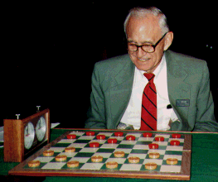
Checkers: Tinsley vs. Chinook
Name: Marion Tinsley
Profession: Teach mathematics
Hobby: Checkers
Record: Over 42 years loses only 3 games of checkers
World champion for over 40 years
Checkers was solved in April 2007: from the standard starting position, both players can guarantee a draw with perfect play. This took 10¹⁴ calculations over 18 years. Checkers has a search space of size 5 × 10²⁰
Mr. Tinsley suffered his 4th and 5th losses against Chinook (1990)

Slide 71
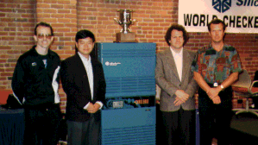
Chinook
First computer to become official world champion of Checkers!

Slide 72
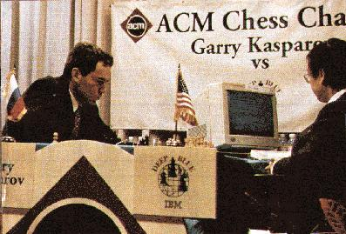
Chess: Kasparov vs. Deep Blue
Kasparov
5’10”
176 lbs
34 years
50 billion neurons
2 pos/sec
Extensive
Electrical/chemical
Enormous
Height
Weight
Age
Computers
Speed
Knowledge
Power Source
Ego
Deep Blue
6’ 5”
2,400 lbs
4 years
32 RISC processors + 256 VLSI chess engines
200,000,000 pos/sec
Primitive
Electrical
None
1997: Deep Blue wins by 3 wins, 1 loss, and 2 draws
Jonathan Schaeffer

Slide 73
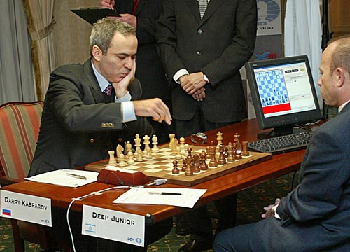
Chess: Kasparov vs. Deep Junior
Deep Junior
8 CPU, 8 GB RAM, Win 2000
2,000,000 pos/sec
Available at $100
August 2, 2003: Match ends in a 3/3 tie!

Slide 74
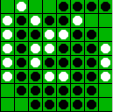
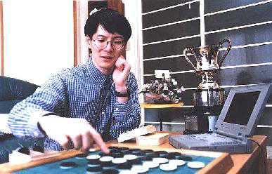
Othello (Reversi): Murakami vs. Logistello
Takeshi Murakami
World Othello Champion
1997: The Logistello software crushed Murakami by 6 games to 0

Slide 75
Secrets
Many game programs are based on alpha-beta pruning + iterative deepening + transposition tables (hash tables containing minimax values) + huge databases + ...
For instance, Chinook searched all checkers configurations with 8 pieces or less and created an endgame database of 444 billion board configurations
The methods are general, but their implementation is dramatically improved by many specifically tuned-up enhancements (e.g., the evaluation functions)

Slide 76
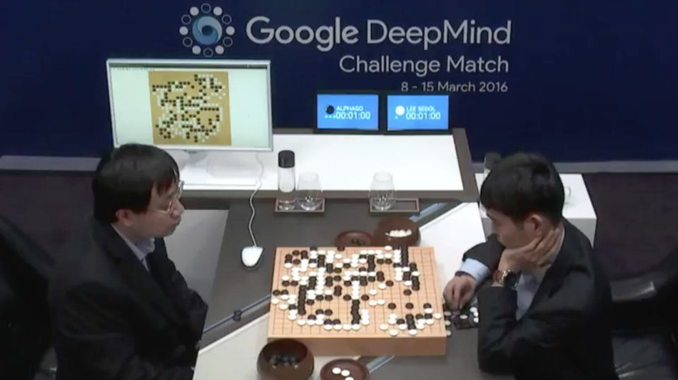
Milestone: Go (2016)
Google’s AlphaGo beats Lee Sodol (9-dan player), March 2016
Notes:
-March of 2016
Why is go hard?
Biggest branching factor and state space of any of these games by a huge margin…
A year ago, programs still lost to moderatly tallended players
Lee Sodol, who lost, was ranked 2nd best player in the world
How? Min Max search, evaluation function based on deep learning: If we can search far, we need a good way of understanding the board

Slide 77
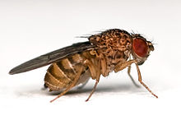
Perspective on Games: Con and Pro
Chess is the Drosophila of artificial intelligence. However, computer chess has developed much as genetics might have if the geneticists had concentrated their efforts starting in 1910 on breeding racing Drosophila. We would have some science, but mainly we would have very fast fruit flies.
John McCarthy
Saying Deep Blue doesn’t really think about chess is like saying an airplane doesn't really fly because it doesn't flap its wings.
Drew McDermott
Notes:
Drosophila = fruit fly

